Slide 1

L6 Group-1 Pitch 5
Caitlin White, Connor Wilby, Jamie Chandler and Jordan Marks

Slide 2
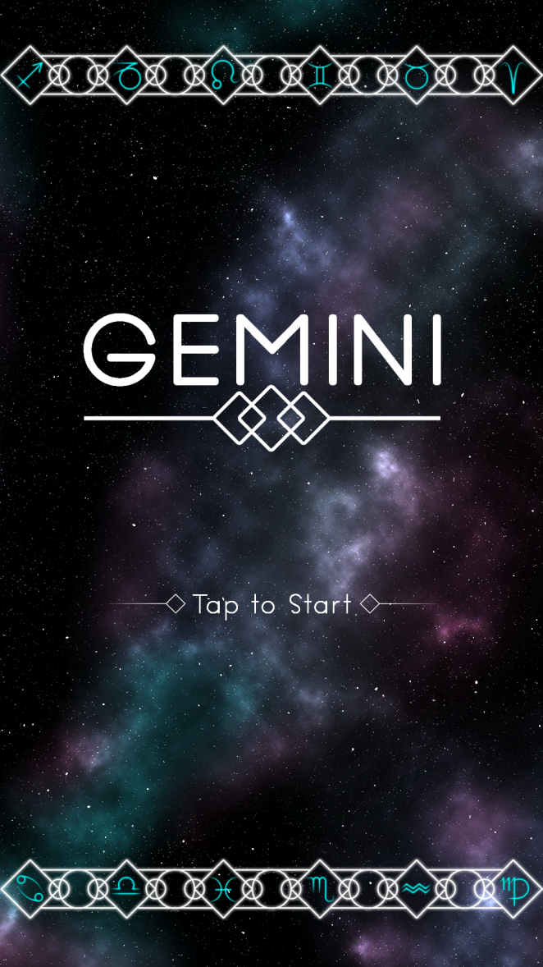
Our Brief
Mobile Platform
Potential for monetisation
Inclusion of smart depth
CW

Slide 3
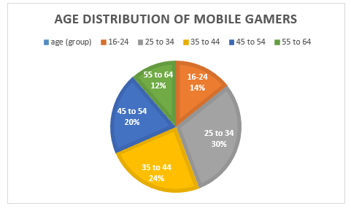
Demographic
Age: 25-44
Gender: Female
Source: http://www.realitymine.com/myth-busting-mobile-gaming-demographics/
JM

Slide 4
Psychographic
Emily
Favourite colour: Purple
Enjoys her own casual style
Enjoys shopping and reading in her spare time
Enjoys matching games
Times she spends each day on games: 2 hrs
Enjoys using social networks in the evening when she gets home to connect with her family and friends
JM

Slide 5

Platform and Genre
Platform: Mobile and Tablet
Genre: Hex based Puzzle
Duration: Up to 5 minutes
CW

Slide 6


What the player does
Creating an unbroken chain of hexes
Optimisation game
Each starsign having a unique mechanic
JC

Slide 7
The Game Loop
Level start
Move tiles
Complete level
Earn rewards
JC

Slide 8
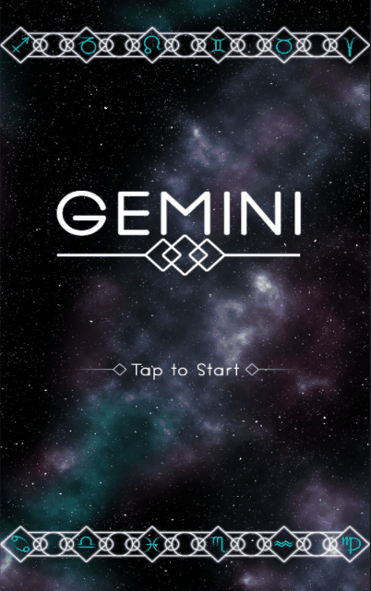
Gameplay

Slide 9
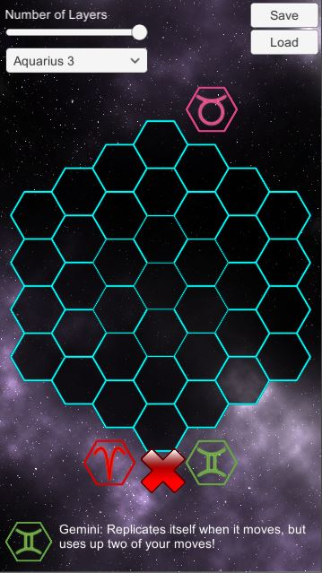
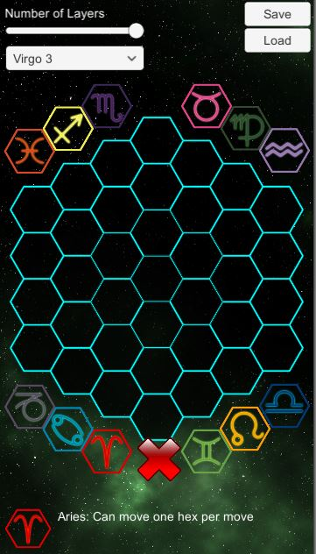
Level Editor
CJ

Slide 10


Tile Mechanics
Basic single movement
Cloning movement
Knight movement
CJ

Slide 11
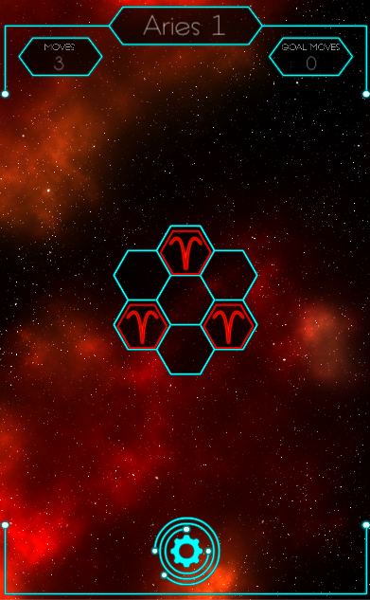
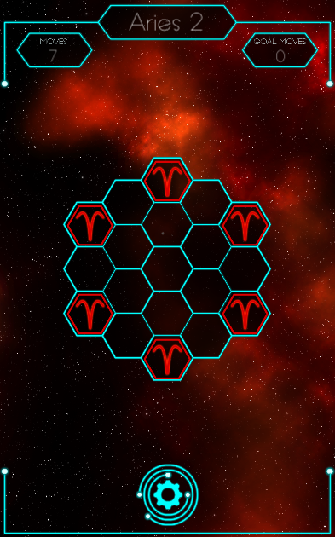
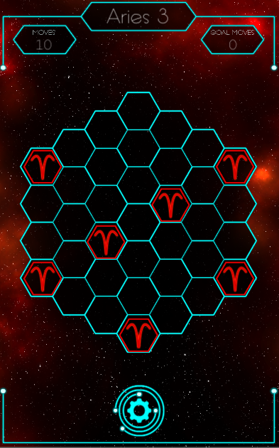
Levels examples
JC

Slide 12
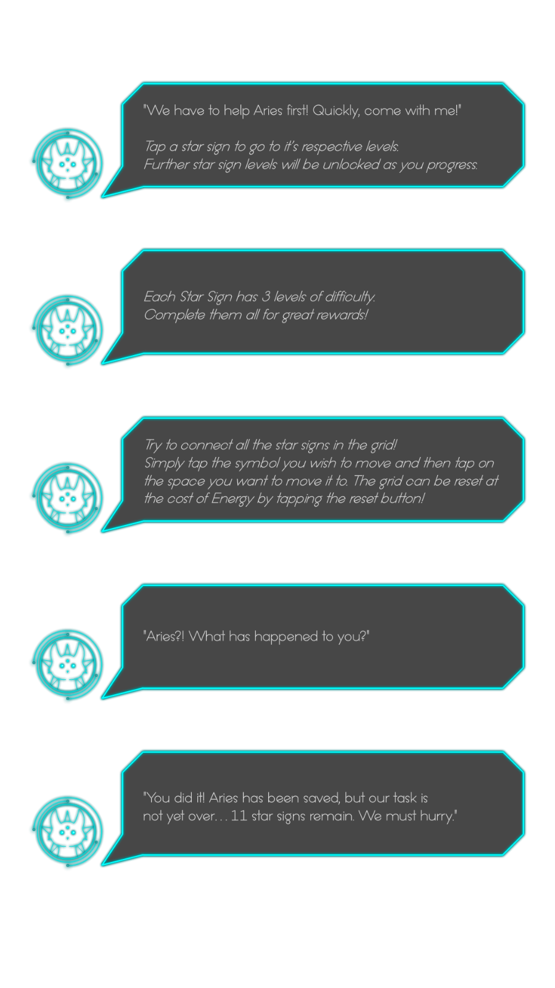
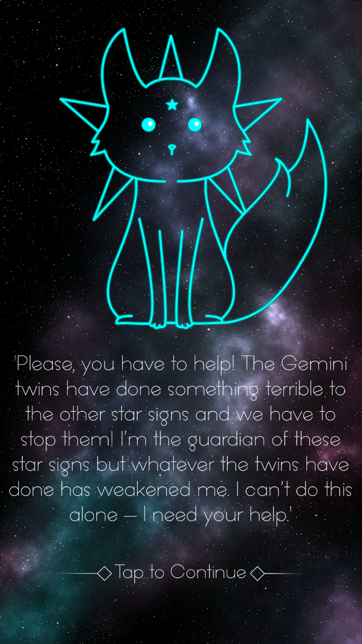
Narrative
JC

Slide 13
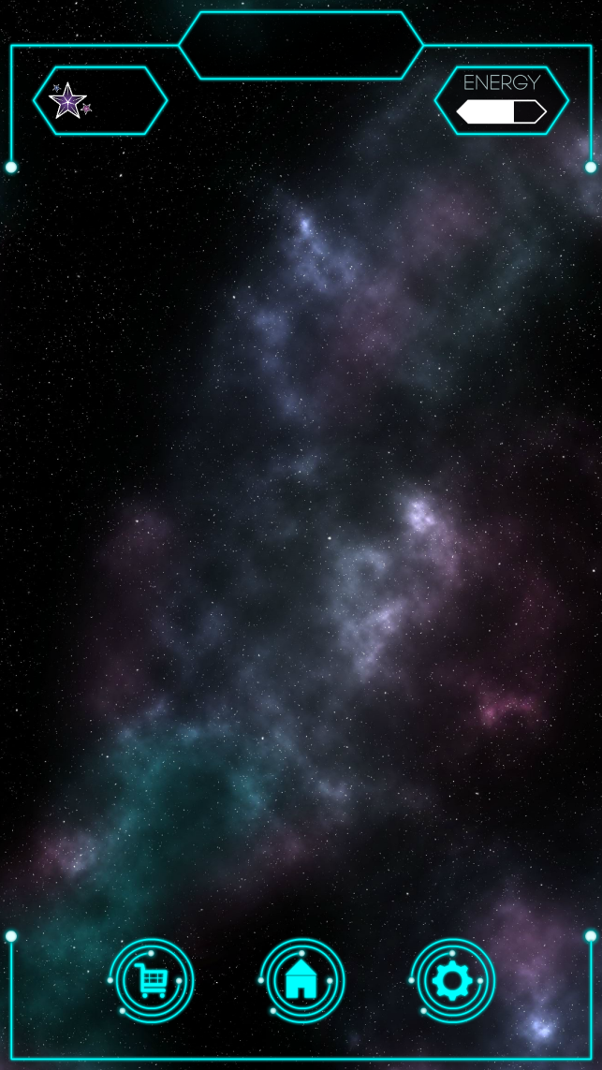

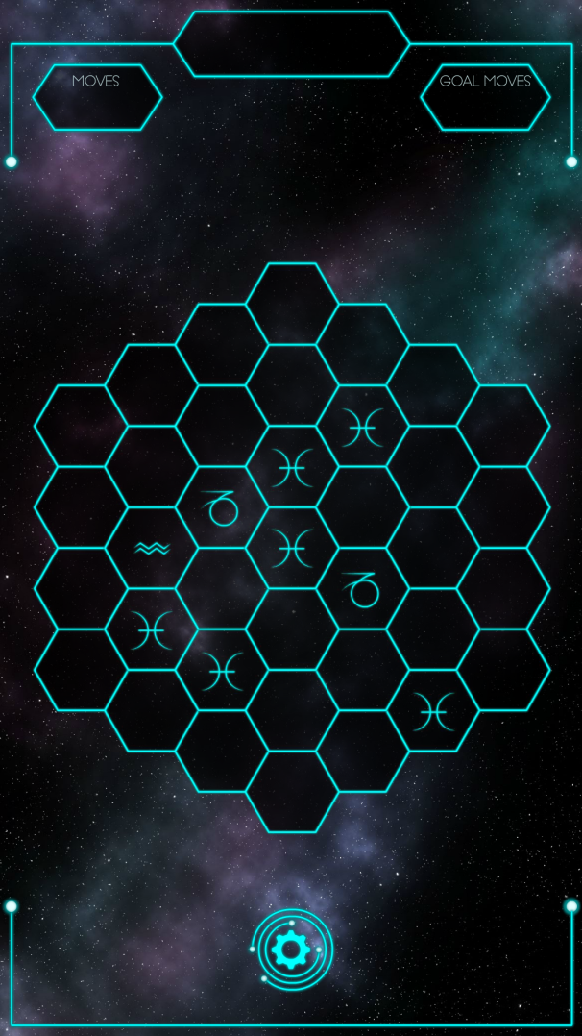

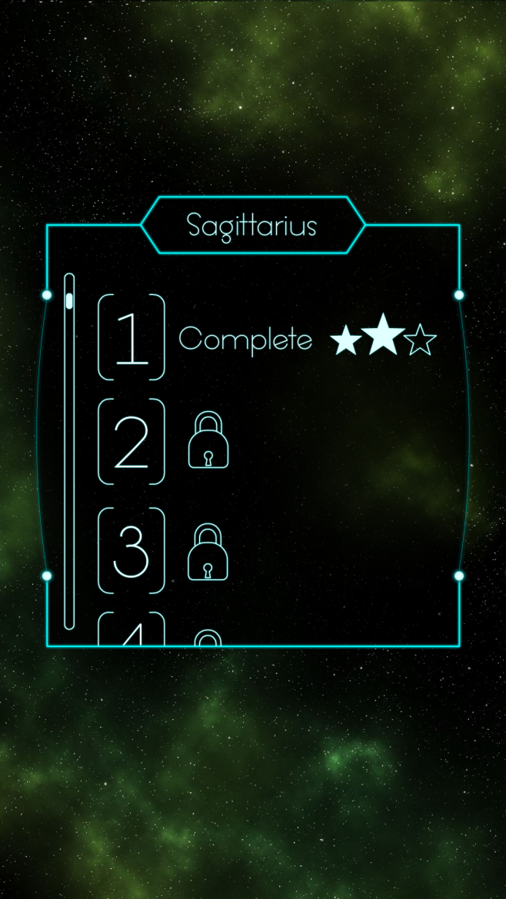
Reworked UI
CW

Slide 14

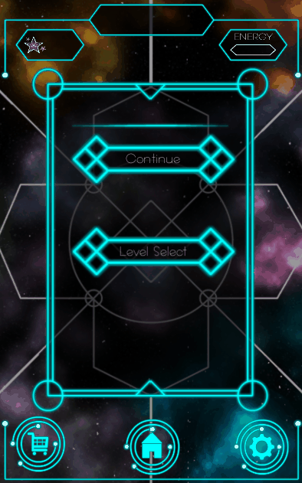
Currency & Power Ups
Stardust
Pricing from 99p to £59.99
Refill Lives/Stamina
Power-ups
Extra Moves
Place an extra symbol
Hint outline
Daily Login bonuses
JM

Slide 15
Iteration based on user feedback
Levels made or changed based on player feedback.
UI reworked.
Changed from using an overworld to a Level select.
JM

Slide 16
Work hours
Individual work hours
Jordan – 1 week, 4 days, 6 hours, 11 minutes (94h)
Jamie – 1 week, 3 days, 1 hours, 30 minutes (81h)
Caitlin – 2 weeks, 2 days, 3 hours, 10 minutes (139h)
Connor – 2 weeks, 1 day (120h)
Hours overall – 8 weeks, 2 days, 1 hours, 51 minutes (465h)
CJ

Slide 17
Questions?

